Slide 1
Natural Language Understanding
atjahyanto@gmail.com

Slide 2
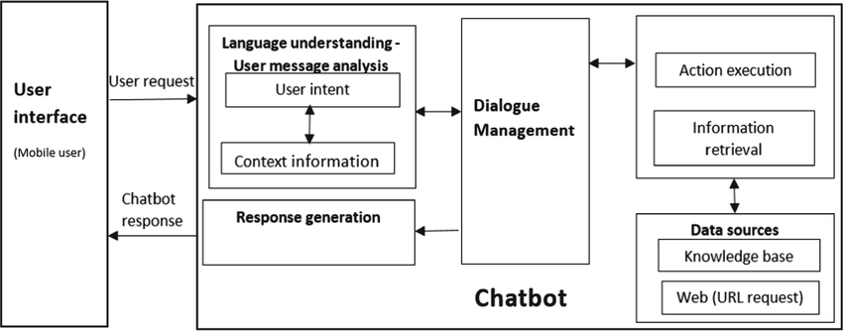
Chatbot Architecture

Slide 3
Natural Language Understanding (NLU)
Memahami makna dari teks atau ucapan manusia secara semantik dan kontekstual.
Memungkinkan mesin untuk memahami apa yang dimaksud oleh pengguna, bukan hanya mengenali kata-kata secara harfiah.
Mengenali maksud atau tujuan (intent) dari suatu kalimat.
Mengidentifikasi entitas penting (entities) di dalam teks.
Menangani ambiguitas, idiom, dan struktur bahasa alami.
Memahami konteks dan hubungan antar kalimat.
Understanding the semantic and contextual meaning of human text or speech.
Enables machines to understand the user’s intent, rather than just recognizing words literally.
Recognize the intent of a sentence.
Identify important entities in text.
Handle ambiguity, idioms, and natural language structures.
Understand context and relationships between sentences.
User input: “Set an alarm for 7 a.m. tomorrow.”

Slide 4
Natural Language Understanding (NLU)
Intent Detection
User
Input
Intent
Entities
Pre-Processing
Parsing & Tagging
Post-Processing
Named Entity Recognition
Intent: set_alarm
Entities: time=7 a.m., date=tomorrow
“Set an alarm for 7 a.m. tomorrow.”

Slide 5
NLU: Pre-Processing
Membersihkan dan menyiapkan teks mentah agar bisa diproses oleh model NLP atau machine learning dengan lebih baik.
Menghilangkan noise dari teks
Membuat struktur teks menjadi lebih konsisten
Mempercepat dan meningkatkan akurasi model NLP
Memastikan input yang relevan dan bersih
Cleaning and preparing raw text for better processing by NLP or machine learning models.
Removing noise from text
Making text structure more consistent
Speeding up and improving the accuracy of NLP models
Ensuring relevant and clean input

Slide 6
General Stages of Preprocessing

Slide 7
Tokenization
Memecah teks menjadi unit-unit kecil yang disebut token.
Token adalah kata tunggal, tetapi dalam beberapa kasus, token bisa berupa frasa (multi-word expressions)
Breaking text into smaller units called tokens.
A token is a single word, but in some cases, a token can be a phrase (multi-word expression)
"I visited New York last summer and learned about machine learning in a workshop.“
Single word token:
['I', 'visited', 'New', 'York', 'last', 'summer', 'and', 'learned', 'about', 'machine', 'learning', 'in', 'a', 'workshop’]
Phrase token:
['I', 'visited', 'New York', 'last', 'summer', 'and', 'learned', 'about’,
'machine learning', 'in', 'a', 'workshop']
New York
machine learning
United Nations
coffee shop

Slide 8
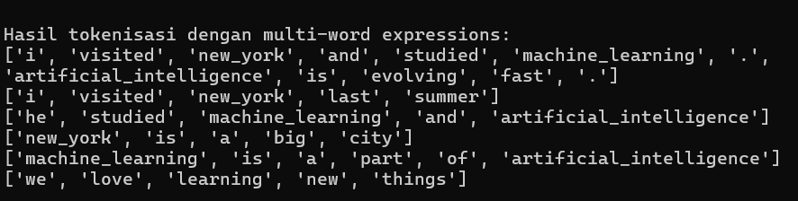
Tokenization: Multi-Word
from gensim.models import Phrases
from gensim.models.phrases import Phraser
from nltk.tokenize import word_tokenize
import nltk
nltk.download('punkt')
# Contoh korpus kalimat
sentences = [
"I visited New York and studied machine learning. Artificial intelligence is evolving fast.",
"I visited New York last summer",
"He studied machine learning and artificial intelligence",
"New York is a big city",
"Machine learning is a part of artificial intelligence",
"We love learning new things"
]
# Tokenisasi kata
tokenized_sentences = [word_tokenize(sentence.lower()) for sentence in sentences]
nthreshold = 4 # semakin rendah, semakin gampang digabung menjadi frase
# threshold=10 → hanya frasa sangat kuat yang digabung.
nmin_count = 2 # jumlah minimum kemunculan kata untuk dipertimbangkan.
# Jika terlalu tinggi, frasa jarang tidak akan dideteksi.
# Latih model bigram untuk mendeteksi frasa
bigram = Phrases(tokenized_sentences, min_count=nmin_count, threshold=nthreshold) # Atur threshold rendah agar mudah terlihat
bigram_phraser = Phraser(bigram)
# Terapkan model ke kalimat yang sudah ditokenisasi
phrased_sentences = [bigram_phraser[sent] for sent in tokenized_sentences]
# Tampilkan hasil
print("\n\nHasil tokenisasi dengan multi-word expressions:")
for sent in phrased_sentences:
print(sent)
Try to make experiment using different thresholds and min_count :
4 and 2
8 and 1
10 and 1
Etc
What if a new sentence is added?

Slide 9
Normalization or Standardize text format
Proses menyederhanakan dan menyeragamkan teks input dari user supaya lebih mudah diproses oleh model NLP.
Mengurangi variasi teks yang tidak relevan dan yang bisa mengganggu analisis.
Lowercasing (case-folding)
Punctuation removal
Whitespace normalization
Stopwords removal (opsional)
Stemming atau Lemmatization
Handling typo atau slang
The process of simplifying and standardizing user input text to make it easier for the NLP model to process.
Reducing irrelevant text variations that can interfere with analysis.
Lowercasing (case-folding)
Punctuation removal
Whitespace normalization
Stopwords removal (optional)
Stemming or Lemmatization
Handling typos or slang
Reduce input variation → increase accuracy.

Slide 10
Normalization or Standardize text format

Slide 11
Normalization or Standardize text format
import re
import string
# Kamus ekspansi kontraksi (bisa diperluas)
contractions_dict = {
"i'm": "i am",
"can't": "cannot",
"don't": "do not",
"idk": "i do not know",
"won't": "will not",
"it's": "it is",
"i've": "i have",
"you're": "you are",
"we're": "we are",
"they're": "they are",
"wanna": "want to",
"gonna": "going to",
"pls": "please",
"asap": "as soon as possible"
}
# Fungsi ekspansi kontraksi
def expand_contractions(text, contractions=contractions_dict):
pattern = re.compile(r'\b(' + '|'.join(re.escape(key) for key in contractions.keys()) + r')\b')
return pattern.sub(lambda x: contractions[x.group().lower()], text)
# Fungsi normalisasi
def normalize_text(text):
text = text.lower() # lowercase
text = expand_contractions(text) # ekspansi kontraksi
text = re.sub(r'\d+', '<NUM>', text) # ganti angka dengan <NUM>
text = re.sub(r'[' + string.punctuation + ']', '', text) # hapus tanda baca
text = re.sub(r'\s+', ' ', text).strip() # hapus spasi berlebih
return text
# Contoh kalimat
sentences = [
"HELLO!!! I wanna KNOW the OPENING hours pls!!! 😅",
"When's the shop open? I need info ASAP!!!",
"I've got 2 dogs & 3 cats.",
"Thanks soooo much!!! 🙏🙏",
"Idk why it’s taking soooo long :("
]
# Normalisasi
for s in sentences:
normalized = normalize_text(s)
print(f"Original: {s}")
print(f"Normalized: {normalized}")
print()

Slide 13
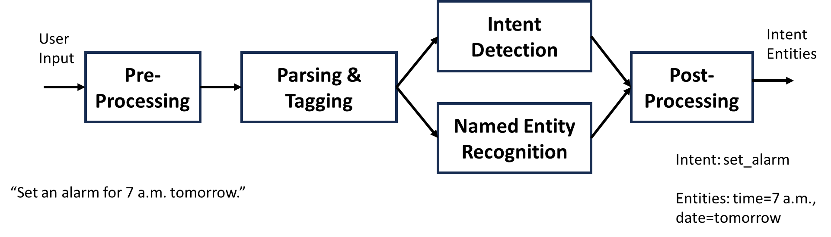
Parsing and Tagging
Membaca struktur dan makna teks secara lebih mendalam.
Setelah preprocessing dan tokenization
Sebelum masuk ke tahap intent classification atau entity recognition.
Read the structure and meaning of the text in more depth.
After preprocessing and tokenization
Before entering the intent classification or entity recognition stage.

Slide 14
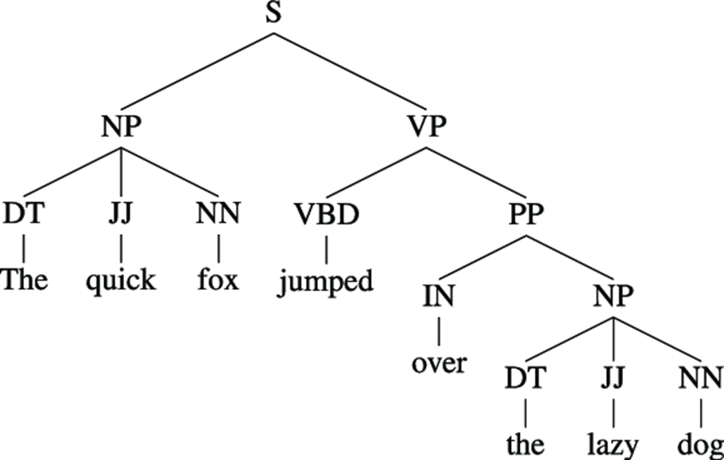
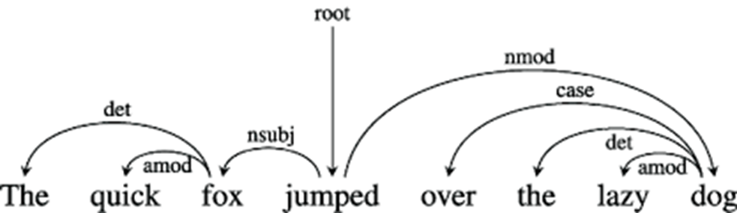
Parsing: Understanding the structure of sentence
Menganalisis struktur sintaksis sebuah kalimat berdasarkan grammar.
Mengetahui bagaimana kata-kata dalam kalimat saling berhubungan (siapa subjek, predikat, objek, dll.).
Analyze the syntactic structure of a sentence based on grammar.
Know how words in a sentence relate to each other (who is the subject, predicate, object, etc.).

Slide 15
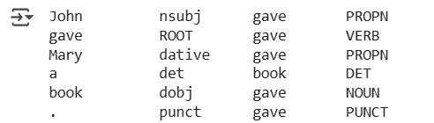
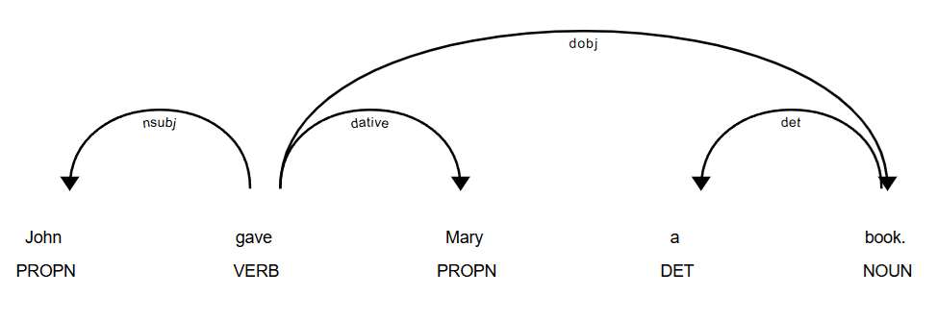
How to use parsing to understand a sentence?
import spacy
# Load pre-trained English model
# # Bisa ganti dengan "id_core_news_sm"
nlp = spacy.load("en_core_web_sm")
# Contoh kalimat
sentence = "John gave Mary a book."
# Proses parsing
doc = nlp(sentence)
# Cetak hasil dependency parsing
for token in doc:
print(f"{token.text:<12} {token.dep_:<10} {token.head.text:<10} {token.pos_:<6}")
# Visualisasi dependency
spacy.displacy.render(doc, style="dep")
root_token = [token for token in doc if token.dep_ == "ROOT"][0]
print("Root word:", root_token.text)
Get main verb (root)
Root word: Give
Spacy version 2.3.9

Slide 16
Dependency Parsing
Menganalisis struktur gramatikal kalimat dengan cara mengidentifikasi hubungan sintaksis antar kata.
Memahami siapa melakukan apa kepada siapa, yang merupakan inti dari pemahaman makna kalimat oleh mesin.
Analyze the grammatical structure of sentences by identifying syntactic relationships between words.
Understanding who did what to whom, which is the core of machine understanding of sentence meaning.

Slide 17
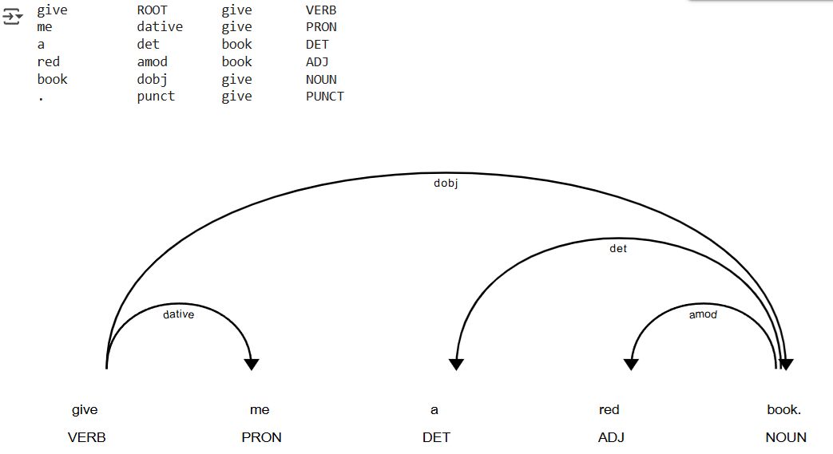
How to use parsing to understand a sentence?
Memahami hubungan antar entitas (subjek, objek, kata kerja).
Mengetahui siapa melakukan aksi terhadap apa (atau siapa).
Get main verb (root)
Understanding the relationships between entities (subject, object, verb).
Knowing who does what (or whom) to what.
sentence = "give me a red book."
Give what?
Give to whom?
Root word: Give

Slide 18
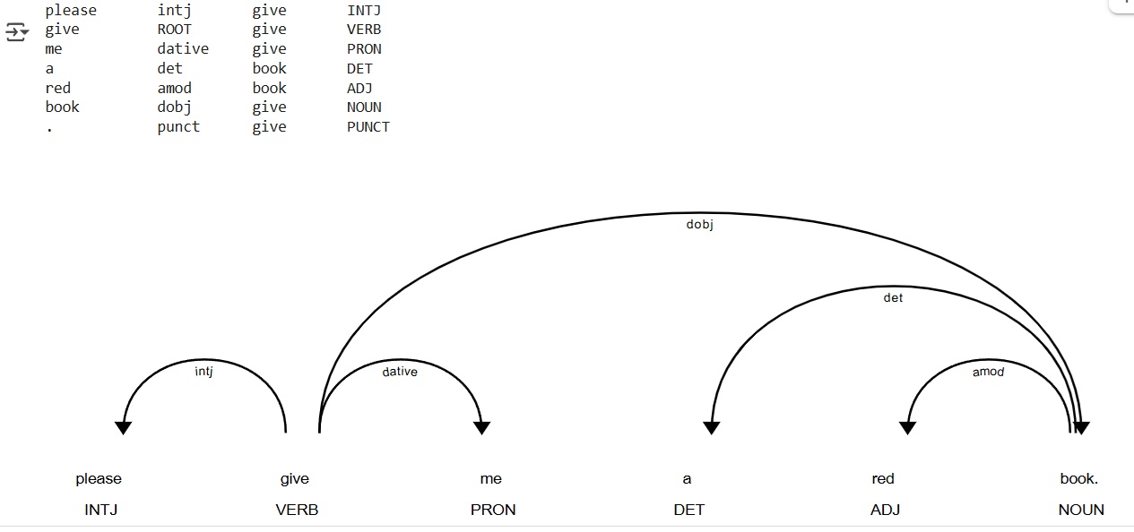
How to use parsing to understand a sentence?
Get main verb (root)
sentence = “please give me a red book."
Root word: Give

Slide 19
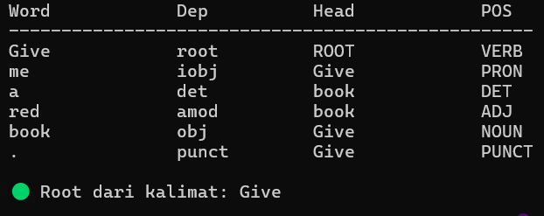
How to use parsing to understand a sentence?
import stanza
# Unduh model jika belum tersedia
stanza.download('en')
# Inisialisasi pipeline
nlp = stanza.Pipeline(lang='en', processors='tokenize,pos,lemma,depparse')
# Kalimat input
text = "Give me a red book."
# Proses teks
doc = nlp(text)
# Ambil kalimat pertama
sentence = doc.sentences[0]
# Cetak header
print(f"{'Word':<15} {'Dep':<12} {'Head':<15} {'POS'}")
print("-" * 50)
# Cetak isi tabel
for word in sentence.words:
head_word = "ROOT" if word.head == 0 else sentence.words[word.head - 1].text
print(f"{word.text:<15} {word.deprel:<12} {head_word:<15} {word.upos}")
# Cari dan tampilkan kata root
for word in sentence.words:
if word.deprel == "root":
print(f"\n🟢 Root dari kalimat: {word.text}")
break
Get main verb (root)
Dep (dependency relationship)
Head (head of the word)
POS (part-of-speech)
Give → root
Me → iobj
Main phrase: Give me
Stanza version: 1.10.1

Slide 20
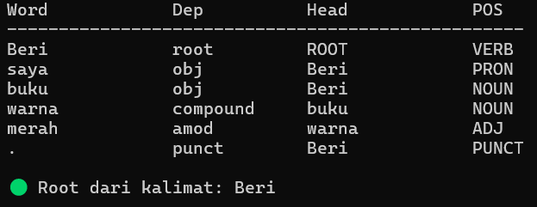
How to use parsing to understand a sentence?
import stanza
# Unduh model bahasa Indonesia jika belum tersedia
stanza.download('id')
# Inisialisasi pipeline
nlp = stanza.Pipeline(lang='id', processors='tokenize,pos,lemma,depparse')
# Kalimat input
text = "Beri saya buku warna merah."
# Proses teks
doc = nlp(text)
# Ambil kalimat pertama
sentence = doc.sentences[0]
# Cetak header
print(f"{'Word':<15} {'Dep':<12} {'Head':<15} {'POS'}")
print("-" * 50)
# Cetak isi tabel
for word in sentence.words:
head_word = "ROOT" if word.head == 0 else sentence.words[word.head - 1].text
print(f"{word.text:<15} {word.deprel:<12} {head_word:<15} {word.upos}")
# Cari dan tampilkan kata root
for word in sentence.words:
if word.deprel == "root":
print(f"\n🟢 Root dari kalimat: {word.text}")
break
Get main verb (root)

Slide 21
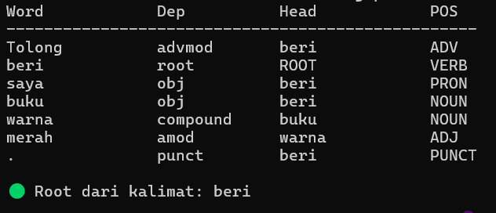
How to use parsing to understand a sentence?
Get main verb (root)
text = "Tolong beri saya buku warna merah."
beri → root
saya → obj
Main phrase: beri saya
Give → root
Me → iobj
Main phrase: Give me
text = “please give me a red book."

Slide 22
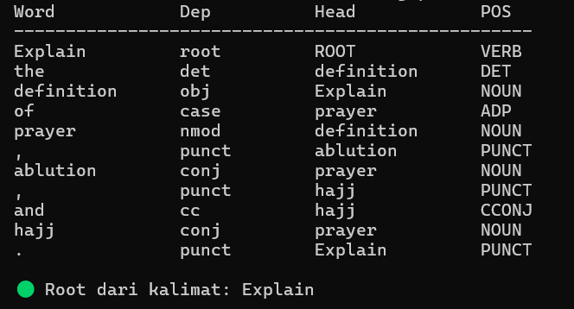
How to use parsing to understand a sentence?
Get main verb (root)
text = "Explain the definition of prayer, ablution, and hajj."

Slide 23
Dependency Relation Label

Slide 25
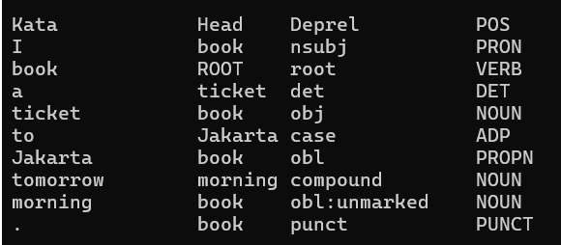
Intent Analysis from Dependency Tree
import stanza
# Inisialisasi pipeline
language = 'en' # 'id'
stanza.download(language)
nlp = stanza.Pipeline(lang=language, processors='tokenize,pos,lemma,depparse')
# Kalimat pengguna
kalimat = "I book a ticket to Jakarta tomorrow morning."
doc = nlp(kalimat)
print ()
# Cetak hasil dependency parsing
for sent in doc.sentences:
print("Kata\t\tHead\tDeprel\t\tPOS")
for word in sent.words:
print(f"{word.text:<10}\t{sent.words[word.head - 1].text if word.head > 0 else 'ROOT'}\t{word.deprel:<10}\t{word.upos}")
Main verb (root): book → main intent (book_ticket)
Direct object (obj): ticket
Destination description (obl): Jakarta
Time description (obl): tomorrow morning

